Slide 1
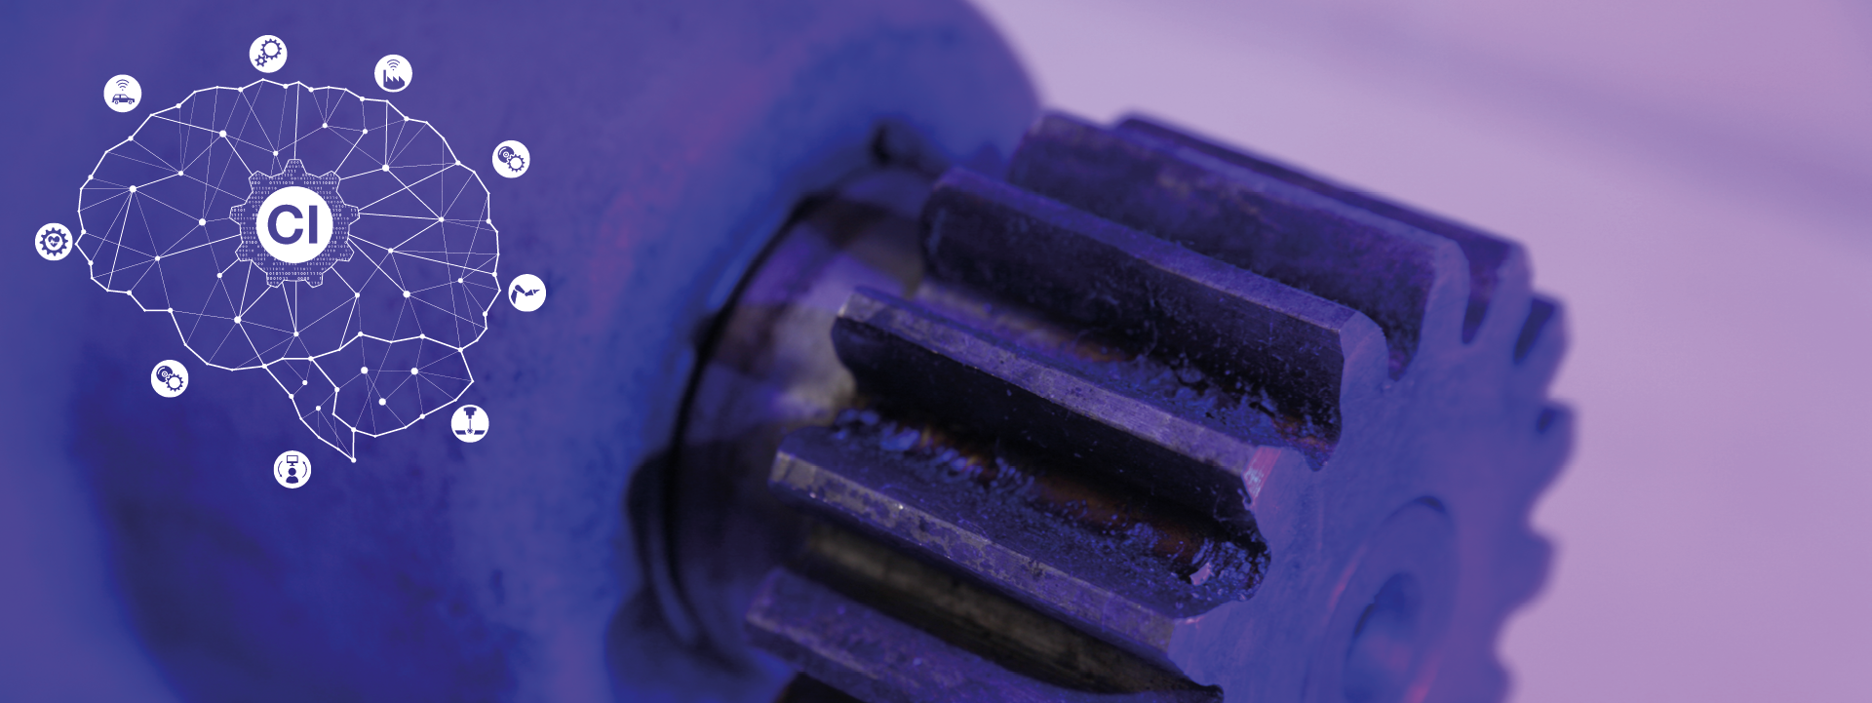
Project B
Group 7:
Sreekar Reddy, Shiva Madha, Tanvi Chinappa, Aparna M Joseph, Atharva Betawadkar
AD

Slide 2
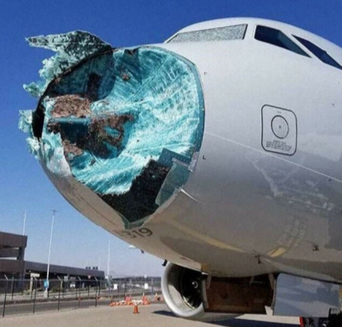
Project Introduction
Pre-Processing:
Tuning:
Model Implementation:
Presentation:
Project B:
Aim: Prediction of impact location
Experimental Setup:
Aluminum plate: 500mm x 500mm x 2mm
4 piezoelectric transducers
2 impact areas (A and B)
Steel ball (d = 4mm) was dropped from H = 50mm
Approx. 50 impact positions

Slide 3
Method
Dataset Parsing
1. Training ‘EPOT_DATA'
2. 'Validation augmented data'
3. 'Experiment'
4. 'Experimental validation'
05
Results : Model Prediction
01
04
Steps
Model Creation
1. Splitting Data
2. Model Creation
3. Tuning and Training
Preprocessing
1. Cutting
2. Augmenting (only for training data)
2. Normalizing
3. Resampling
02
03
Checking For Outliers
Notes:
Explanation of all 4 datasets
Explain preprocessing steps:
i Time selection for cutting of the data?
ii Why only training data was augmented?
iii What was the need for normalizing the data? Could the data have been used without normalizing?
iv Uptil what points was the data resampled? What was the original number of points?
Explain regarding what outliers indicate?
Which all models were used?
Parameters used for model creation?
Prediction

Slide 4
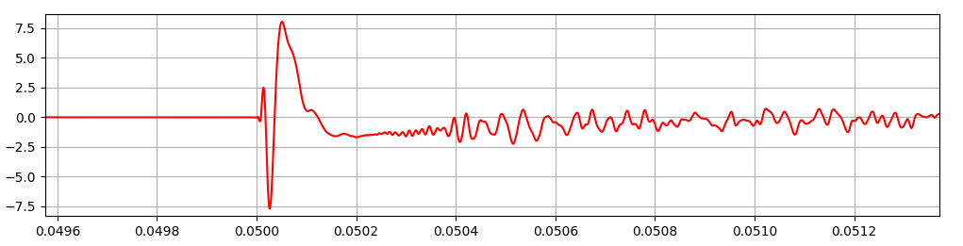
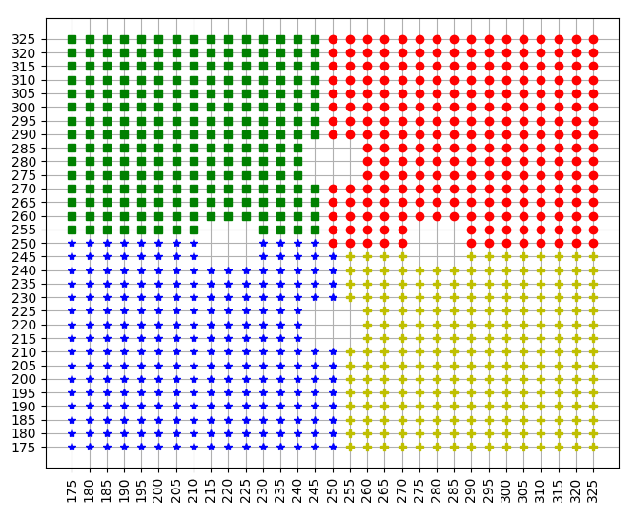
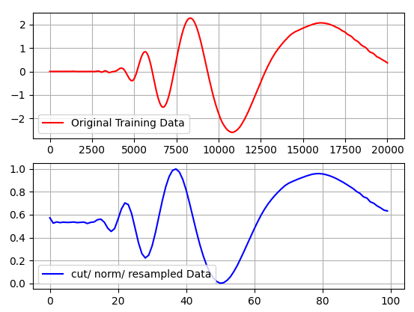
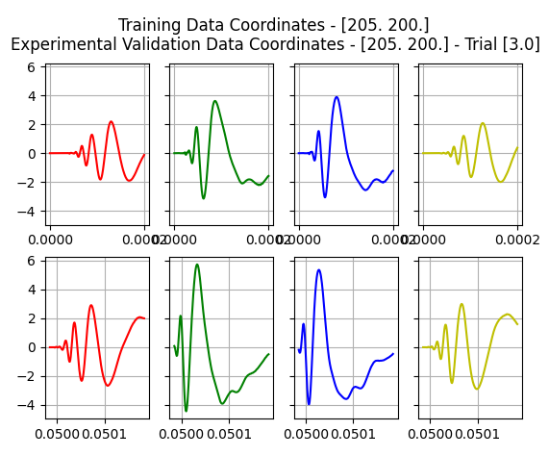
Pre-processing
Training Data:
Length – 0.0002s
Frequency – 1e-8
Experimental Data:
Length – 0.1s
Frequency – 1e-6
Raw Experimental Data
1
2
4
3
Augmentation
244 → 925
Cut/ Normalization / Resampling of Training Data
Compare sensor data at common co-ordinates

Slide 5
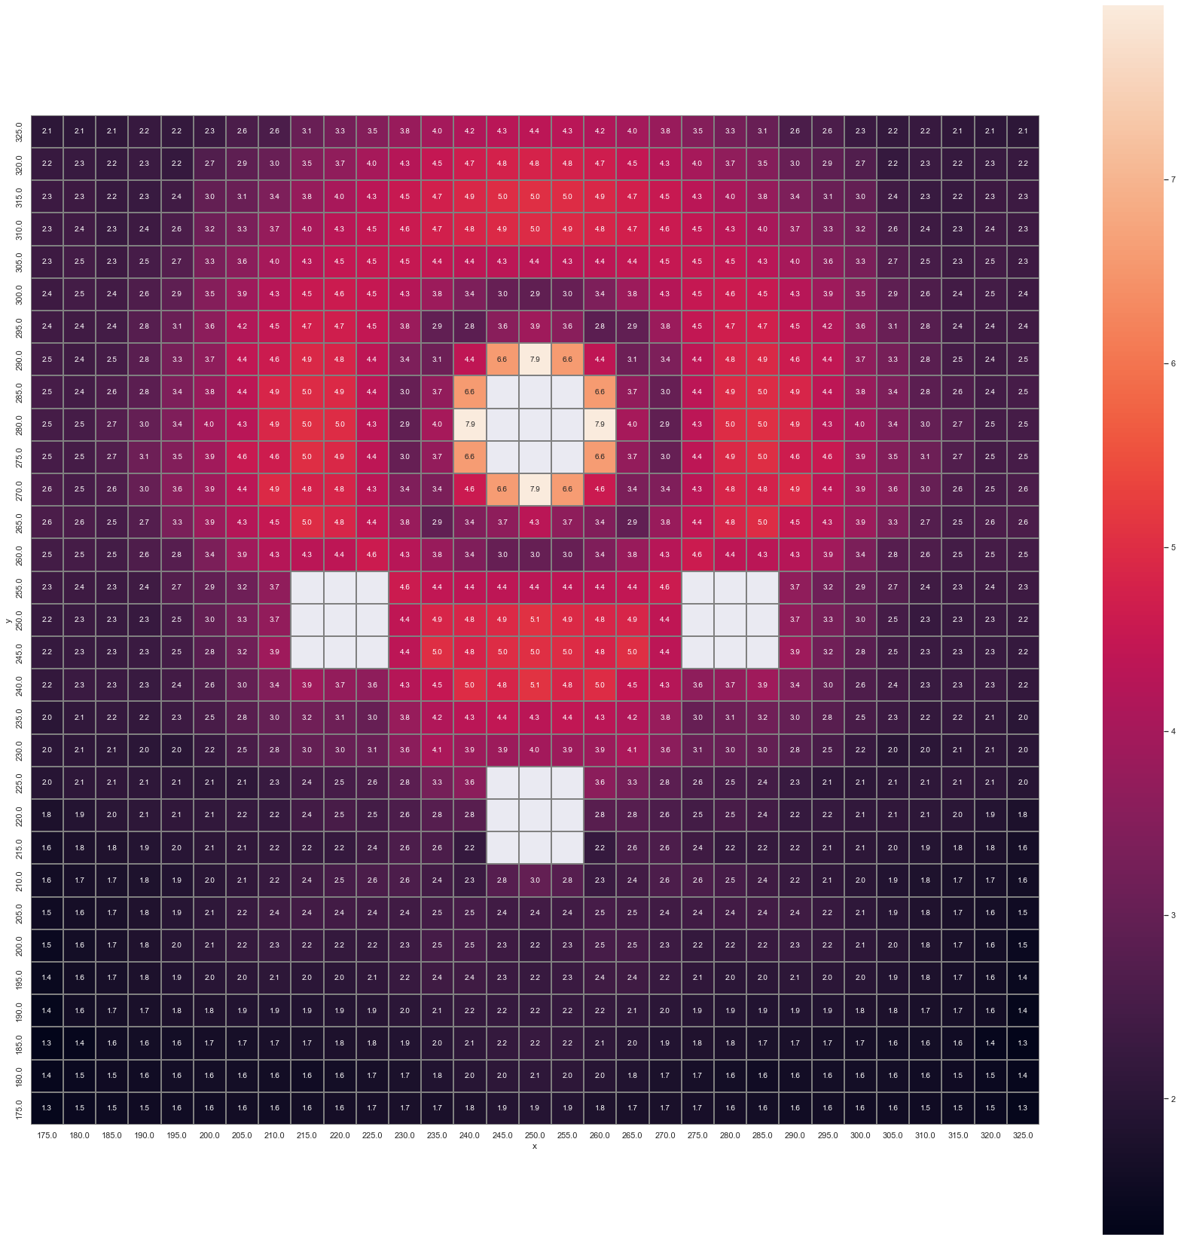
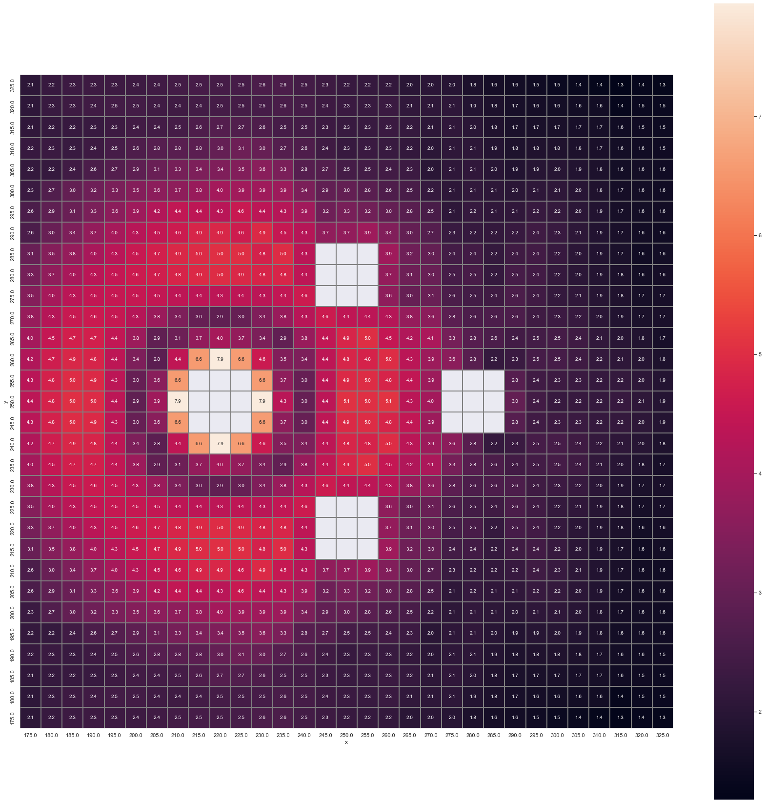
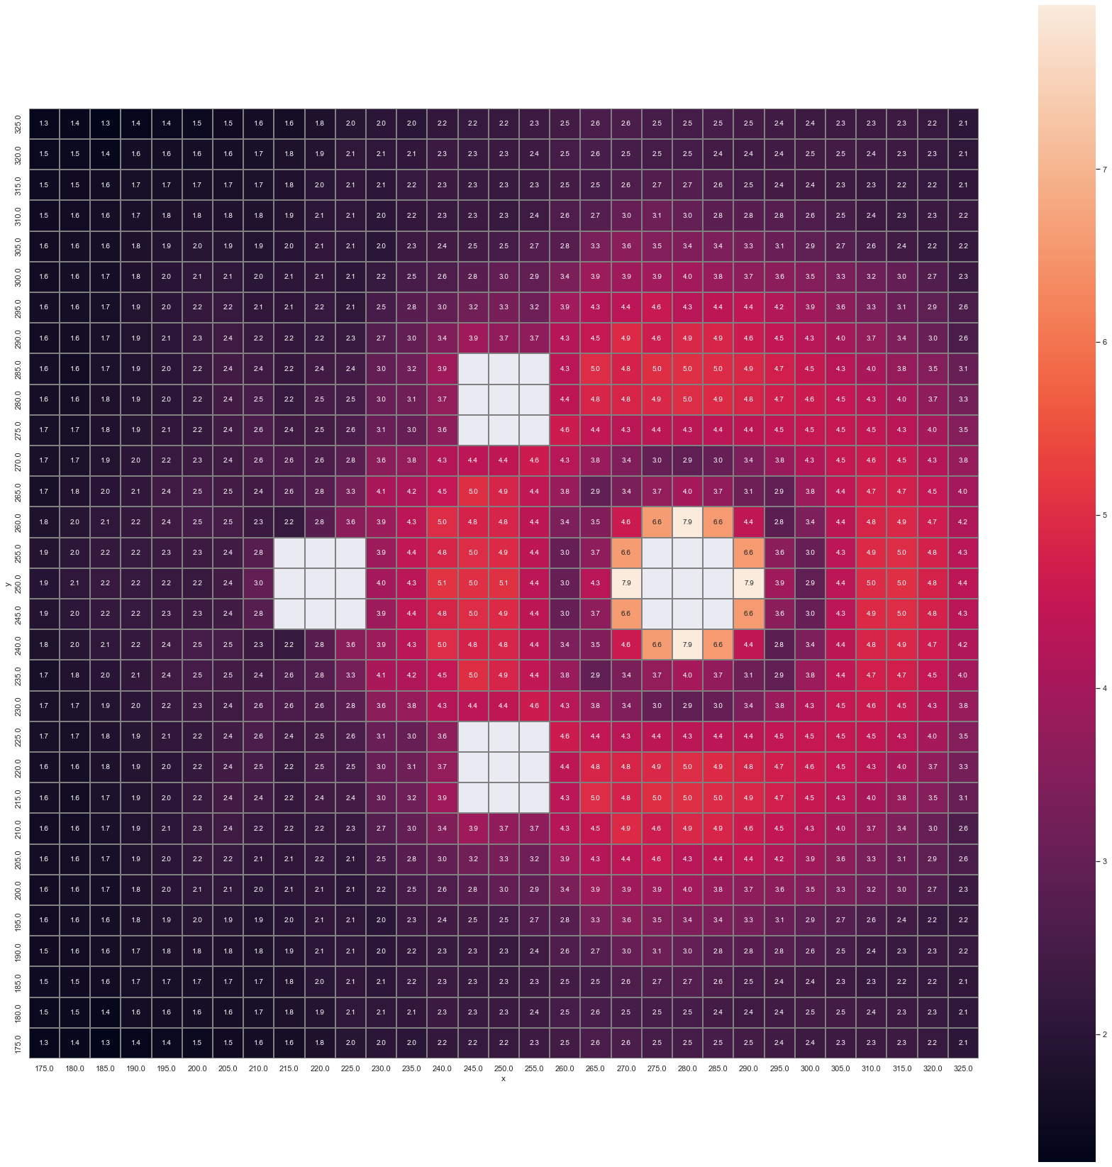
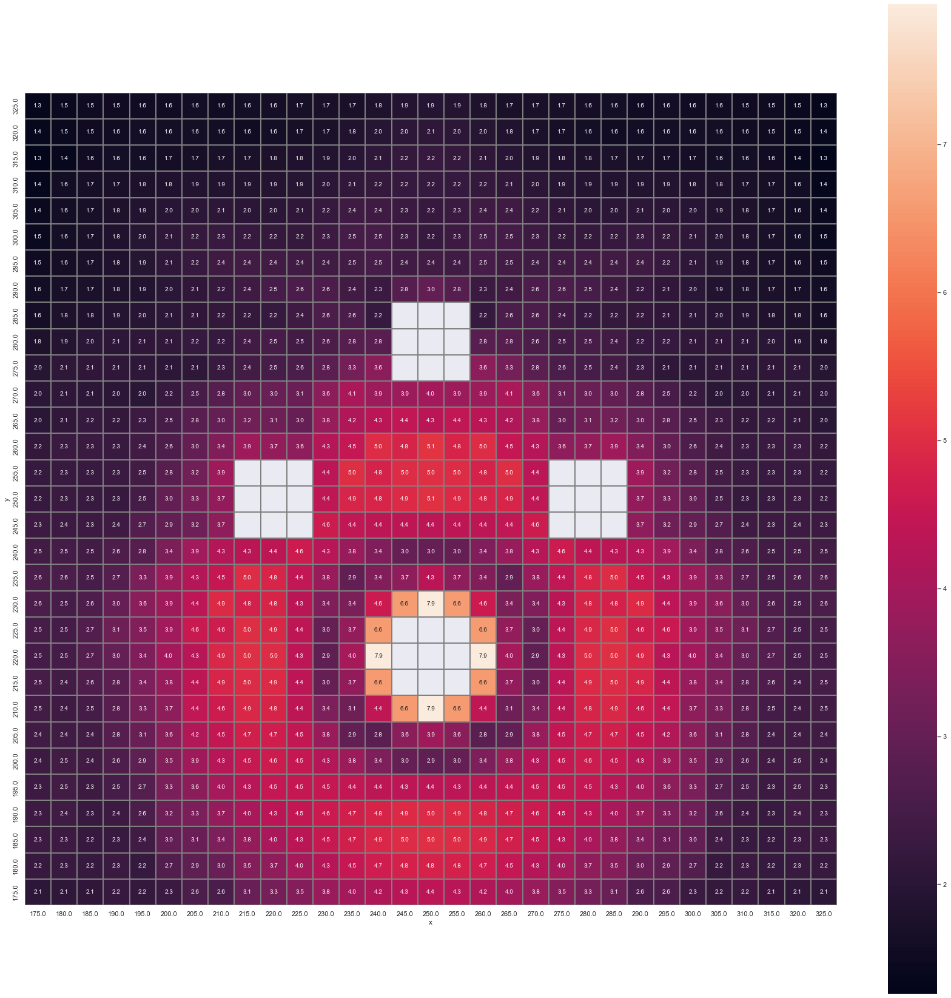
Outliers
Sensor 2
Sensor 4
Sensor 1
Sensor 3

Slide 6
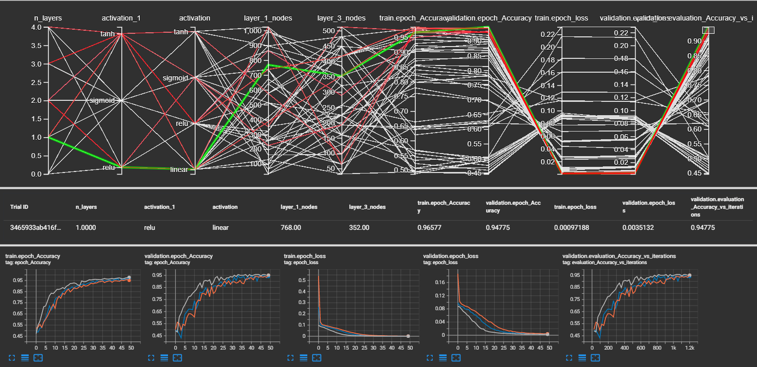
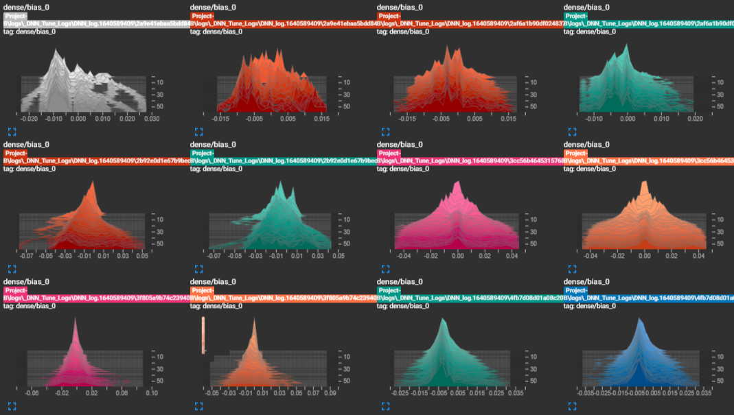
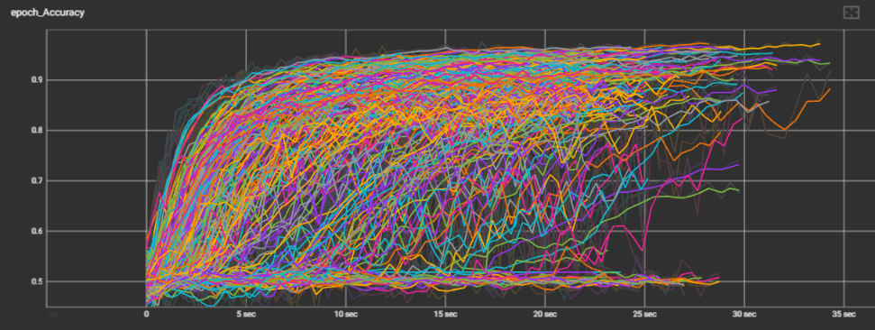
Neural network image for NN model
Select Best Model
Hyperparameters:
-Conv-
N hidden layers
N filters
Kernel size
Strides
Activation function
N Pooling
Pooling size
N Dropouts
Dropout size
Padding type
-Fully Conn-
N dense layers
N neurons
Activation function
-Compile-
Loss
Optimizer
Learning
Accuracy vs Time
Notes:
What are Hyperparameters?
What all did we optimize? How? And what all choices did we give for tuning algorithm?
How does selecting a best model work? - by choosing the top 1% models and checking the learning rates from histograms and sorting by runtime.

Slide 7
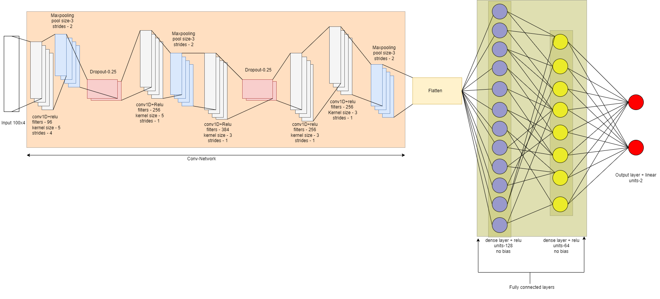
Neural Network Architecture
Accuracy:
Validation accuracy:
Loss:
Validation loss:
MSE (validation data):
MSE (experimental data):
98.38%
97.30%
4.4e-4
3.58e-4
2.27
16.38
Notes:
Test train split - 0.2
Batch size - 32
Epochs-60

Slide 8
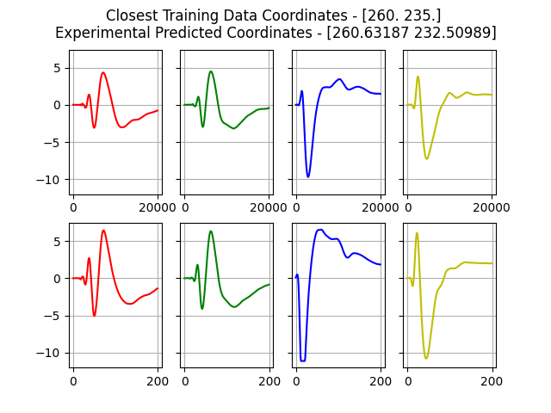
Results & discussion
Experimental Validation Data – (MSE – 16.38 )
Trial 4.0- [205. 200.] Predicted - [209.98865 207.41774]
Trial 3.0- [225. 210.] Predicted - [228.89778 211.16388]
Trial 3.0- [230. 245.] Predicted - [229.48724 243.61864]
Trial 2.0- [240. 255.] Predicted - [240.57103 252.7513 ]
Trial 4.0- [250. 260.] Predicted - [250.5842 260.62122]
Trial 1.0- [300. 235.] Predicted - [296.40793 237.28252]
Experimental Data – Group 7 prediction:
[253.32326, 244.85556]
[234.51955, 233.11015]
[243.45721, 259.58542]
[260.85577, 225.5717 ]
[241.64229, 252.67258]
[262.7103 , 247.9715 ]
[236.75409, 299.41733]
[230.32304, 228.36177]
[264.8639 , 298.7226 ]
[252.88496, 258.21362]
[260.63187, 232.50989]
[252.09583, 252.05911]
[201.56601, 229.92183]
[256.91928, 257.9066 ]
[245.16226, 252.61618]
[224.14635, 201.8915 ]
[269.60422, 310.06744]
[298.5857 , 281.49817]]

Slide 9
conclusion
1.tuning
2. model discussion(why model worked better)

Slide 10
References

